Slide 1
Deploying Deep Learning Models on GPU Enabled Kubernetes Cluster
Mathew Salvaris (@MSalvaris) & Fidan Boylu Uz (@ FidanBoyluUz)
Senior Data Scientists at Microsoft

Slide 2
Basics of Deployment
- Payload, batching, HTTP, Kubernetes
GPU/CPU comparison for inference
Deployment on Kubernetes
Using Kubectl
Using AzureML
Using Kubeflow and TF serving

Slide 3
Deploying
Performant deployment
Talk Examples
Performance
Simple Tutorial
Ease of Use
Notes:
There are many ways to carry out deployments of deep learning models. We want to set expectations as to what these examples represent
If we were to create a graph of ease of use vs performance, it might look something like this
Bottom far right are the simple examples that might just use Flask and don’t talk about putting them in containers, using a proper webserver and deploying on scalable infrastructure
In the top Left are the deployments carried out by organisations that expect the models to handle millions of requests and have very strong latency and throughput requirements. These will often not deploy in Python but will use more performant languages
Finally the examples presented here are faster and more performant that basic tutorials and sacrifice a little of ease of use

Slide 4




penultimate
layer
Cat
Dog
Mouse
RGB Channels
of input image
Convolution layer
with Kernels
Pooling layer
Fully connected layer
Notes:
Familiar to all this is a simple illustration of a CNN
This is an over simplification but is here to get everyone on the same page

Slide 5
Payload
decoded_img = base64.b64decode(request.json["input"])
img_buffer = BytesIO(decoded_img)
pil_img = Image.open(img_buffer).convert("RGB")
Encode into Base64
Transfer as file
Image.open(request.files['image']).convert("RGB")
Notes:
If you have followed a number of tutorials online on how to deploy image classification models you probably come up against two alternatives on how the data is transferred.
A common approach is to encode the image as a base64 string and then send that as JSON. On the server side you will do the above. Grab the json and decode it
Then open it up using PIL or whatever other library you use for loading images. This is nice and simple since you are just passing a string in the JSON object.
The other alternative is that you don’t encode the file but simply create a post request with a file in it. This is easy to handle as you can see above.
By encoding the image as a string we actually increase the payload size. Benchmarking we did showed that this doesn’t significantly affect performance on standard image sizes such as 224 by 224 but with larger images such as 1280 by 1280 the performance penalty becomes quite noticeable.
multipart/form-data

Slide 6
Batching
Non-batched
GPU
Requests
Batched
GPU
Notes:
In this diagram here
Top line no batching
Bottom line batching
Another thing to consider when operationalising models is that GPUs benefit a lot from batching. What this mean in practice is your endpoint should allow for the ability of multiple images to be sent in one request.

Slide 7
HTTP
Multiple
Connections
Persistent
Connections
Pipelining
Head of Line
Blocking
Multiplexing
client
server
client
server
client
server
client
server
client
server
open
open
open
open
open
close
open
time
close
close
close
open
close
close
close
Notes:
Next we talk about the communication between your deployed model and the service calling it
The standard way is with multiple connections. Opening and closing each time. If you are carrying out multiple requests this can be quite slow
The second version is with persistent connections, keep alive. What this does is that it keeps the connection open between requests. This is also what we use when we do throughput testing using asynchronous calls
Now there is also the possibility of pipelining which will allow you to send multiple requests without waiting for a response. The responses though have to be returned in order which lead to the head of line blocking problem, illustrated here
Finally in HTTP 2.0 there is a possibility of using multiplexing what this does is it adds the ability of pipelining without the issue of head of line blocking
Use HTTP 2 if possible and try to avoid head-of-line blocking
gRPC can provide better performance than REST API
So whenever possible you should use HTTP2 and multiplexing to avoid the issues we showed
This is common in gRPC which can also offer better performance due to protobuf
Of course this is only
REST messages typically contain JSON. This is not a strict requirement, and in theory you can send anything as a response, but in practice the whole REST ecosystem—including tooling, best practices, and tutorials—is focused on JSON. It is safe to say that, with very few exceptions, REST APIs accept and return JSON.
gRPC, on the other hand, accepts and returns Protobuf messages. I will discuss the strong typing later, but just from a performance point of view, Protobuf is a very efficient and packed format. JSON, on the other hand, is a textual format. You can compress JSON, but then you lose the benefit of a textual format that you can easily expect.
REST, as mentioned earlier, depends heavily on HTTP (usually HTTP 1.1) and the request-response model. On the other hand, gRPC uses the newer HTTP/2 protocol.

Slide 8

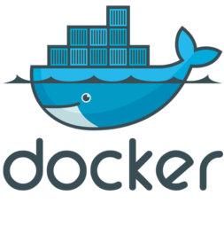

Kubernetes
Node
Node
Node
Cluster
Notes:
Kubernetes is a open-source platform for managing containerized workloads and services. It has a large, rapidly growing ecosystem. Kubernetes services, support, and tools are widely available.
In the diagram above Kubernetes is managing a cluster of three nodes with each node have 1 or more pods.
In the example later we will see that in some cases 1 pod equates to one deployed model
Kubernetes has a number of features. It can be thought of as:
a container platform
a microservices platform
a portable cloud platform and a lot more.

Slide 9
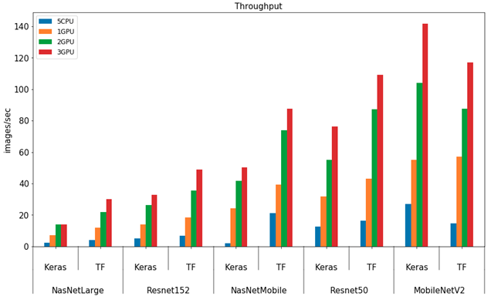
CPU vs GPU
Notes:
A common question that is often asked is if CPU is performant enough for deploying deep learning models. The answer is it depends.
We conducted a set of experiments to test the throughput across a number of models and across Keras and TF
The cluster configurations were 1-3 nodes with K80 GPU
And 5 nodes with 8 CPUs each which totals 40CPUs for the CPU configuration
Price wise the 3 node GPU is equivalent to 5 node CPU
As we can see that the CPU performance is dwarfed by the GPU performance even with 1 GPU
As you might expect smaller models are quicker than larger models
The requests were sent one by one and not batched and using persistent connections and in a asynchronous manner
If they were sent in batches we would probably see an even greater gap in performance

Slide 10
Framework: Keras
Model: ResNet152
Notes:
In the previous tests we didn’t use MKLDNN for CPU and wanted to see if things improved by using it.
As you can see that even with MKLDNN things are still nowhere near GPU performance
We also found that the GPU performance was also more stable. We believe the reason is that with GPUs there is no contention for resources. In the CPU case it has to carry out the CNN computations as well as handle web requests etc.

Slide 11
3 Approaches…
Deploy on Kubernetes with Kubectl
Deploy on Kubernetes with Azure Machine Learning (AzureML/AML)
Deploy on Kubernetes with Kubeflow
Notes:
Deployment by using the Kubernetes command line interface, Kubectl with YAML (or JSON in our case).

Slide 12
Common steps
Develop model
Develop model API
Prepare docker container for web service
Deploy on Kubernetes

Slide 13
Deploy on Kubernetes with Kubectl
Develop model, model API, Flask App
Build container image with model, model API and Flask App
Test locally and push image to Docker Hub
Provision Kubernetes cluster
Connect to Kubernetes with kubectl
Deploy application using manifest (.yaml)

Slide 14




Deploy on Kubernetes with Kubectl
Azure
Request With Payload
Distribute Requests to Pods
Load Balancer
Serve Scoring Requests
Azure
Kubernetes
Services
HTTP
Response
HTTP
Request
Input Data
Pod
Flask App
Data
Prediction
Docker Image
Docker Hub
Model Scoring Function
https://github.com/Microsoft/AKSDeploymentTutorial.git

Slide 15
Deploy on Kubernetes with AzureML
AzureML setup, develop model, register the model to your AzureML Workspace, develop model API (scoring script)
Build image with AzureML using conda dependencies, pip requirements and other dependencies
Pull image from Azure Container Registry (ACR) and test locally
Provision Kubernetes cluster and deploy webservice with AzureML.

Slide 16




Deploy on Kubernetes with AzureML
Azure Machine Learning
Docker Image
Azure Container Registry
Model Registry
Azure Machine Learning
Pod
Web Service
Input Data
HTTP
Request
HTTP
Response
Model Scoring Script
Request With Payload
Microsoft Data Science Virtual Machine
Authenticate and Distribute Requests
to Pods
Azure Machine Learning
Serve Scoring Requests
Azure Kubernetes Services
https://github.com/Microsoft/AKSDeploymentTutorialAML.git

Slide 17
Deploy on Kubernetes with Kubeflow
Develop model and save as TensorFlow servable
Pull TensorFlow Serving image from Docker hub, mount the model path, open REST API port, test locally
Create Kubernetes cluster, attach blob storage on AKS, copy model servable
Install Ksonnet, Kubeflow and deploy webservice using Kubeflow TensorFlow serving Component using ksonnet templates.

Slide 18



Deploy on Kubernetes with Kubeflow
Azure
TensorFlow Docker Image
Docker Hub
Model Servable
Azure Blob Storage
Pod
Web Service
Input Image
HTTP
Request
HTTP
Response
Model Scoring Script
Request With Payload
Distribute Requests
to Pods
TensorFlow Serving Component
Serve Scoring Requests
Azure Kubernetes Services
https://github.com/Microsoft/DeployDLKubeflowAKS.git

Slide 19

Thank You
&
Questions
@Msalvaris
@FidanBoyluUz
http://aka.ms/aireferencearchitectures

